Slide 1
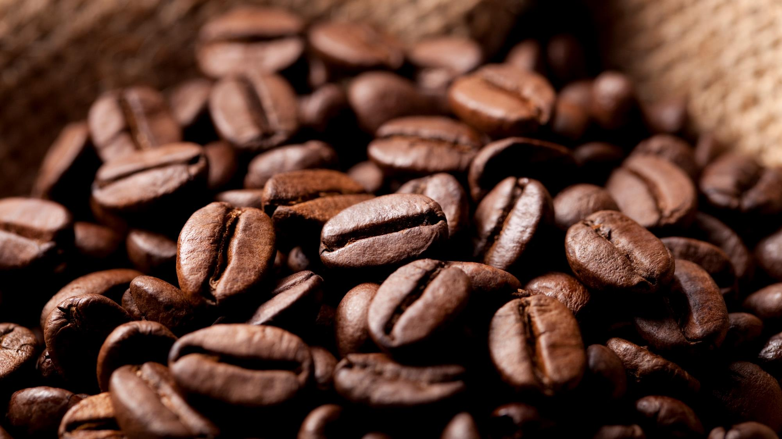
Coffee shop sales
6 months sales analyses
By Yog Gupta | Ws cube tech

Slide 2
KPIs
Total sales
$6,98,812.33
Total footfall
149116
Avg bill/ person
$4.69
Avg order/person
1.44

Slide 3
Quantity ordered based on hours
Are there any peak times for sales activity?
Sales are high during the early breakfast or office opening hours i.e. 7-10 a.m.
The maximum sales at around 10a.m. itself with an average of 26K units in 6 months
June month has shown the maximum sales with around 6K units at the peak hours.

Slide 4
Weekday footfall
How do sales vary by day of the week and hour of the day?
Tuesdays and Fridays observe most order in a week. With highest sales during the early hours of a day and it observes a steep decline with midrange sales(2K units) during lunch hours and then it declines further towards the end of the day.

Slide 5
Location based Footfall
Total sales in each month
January : $81,716
February : $76,144
March : $98,833
April: $118,940
May: $1,56,726
June: $166,485
Across 3 locations, the sales have been quite similar with Hell’s Kitchen being at the top spot every month.

Slide 6
Top 5 products based on sales
Which products are the best-selling in terms of quantity and revenue?
Based on revenue, Barista Espresso > Brewed Chai tea are the highest grossers.
Followed by Hot Chocolate > Gourmet brewed coffee > Brewed black tea.

Slide 7
Size based sales distribution
In terms of quantity:
Regular sized coffees are most ordered while Large and Not defined sizes have equal contribution.
The least ordered size is the Small size coffee.

Slide 8
Sales based on category
How do sales vary by product category and type?
Most of the sales are driven by either coffee or tea with the contribution being greater for the former.
On the sides, Bakery items, drinking chocolate and flavours contribute significantly to the sales.

